Slide 1
Inventory Optimization for Retail Pharmacies
Executive Summary & Recommendations
AJAYI ADEDOTUN TAIWO
JANUARY 11TH, 2025
TOOL: GOOGLE SHEETS

Slide 2
Objectives & Scope
Objectives
Understand inventory imbalances (stock-out risk and overstocking)
Assess alignment between demand forecasting and inventory decisions
Identify supply-side constraints affecting availability
Scope
SKU-level analysis across product categories
Metrics: inventory pressure, lead time risk, reorder parameters, markdown indicators
Tools: Google Sheets

Slide 3
Key Executive Takeaways
70.85% of products are at stock-out risk, indicating widespread inventory imbalance.
89.04% of low-coverage products face lead times longer than their days-on-hand, limiting replenishment recovery.
Inventory pressure is consistently below 0.5 across all categories, showing systemic under-coverage rather than isolated issues.
Inventory imbalance is driven by replenishment and forecasting misalignment, not zero-stock events.

Slide 4
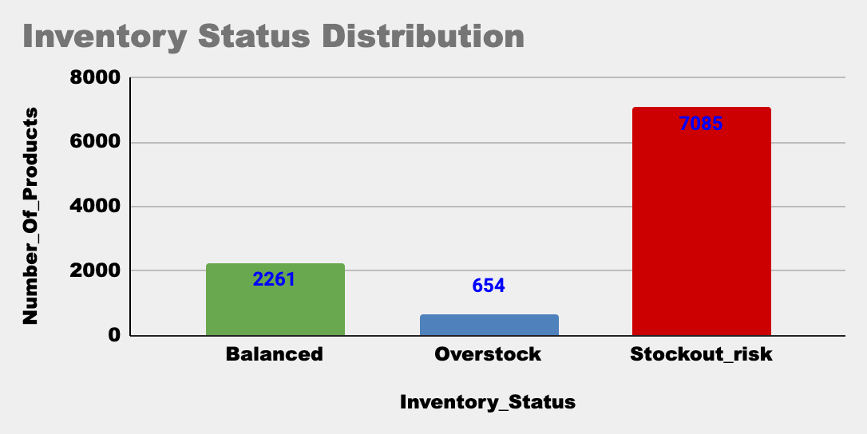
Inventory Balance Overview (Outcome)
Key insight:
Majority of SKUs fall into stock-out risk
Overstock exists but is not the dominant issue
This slide establishes the problem.

Slide 5
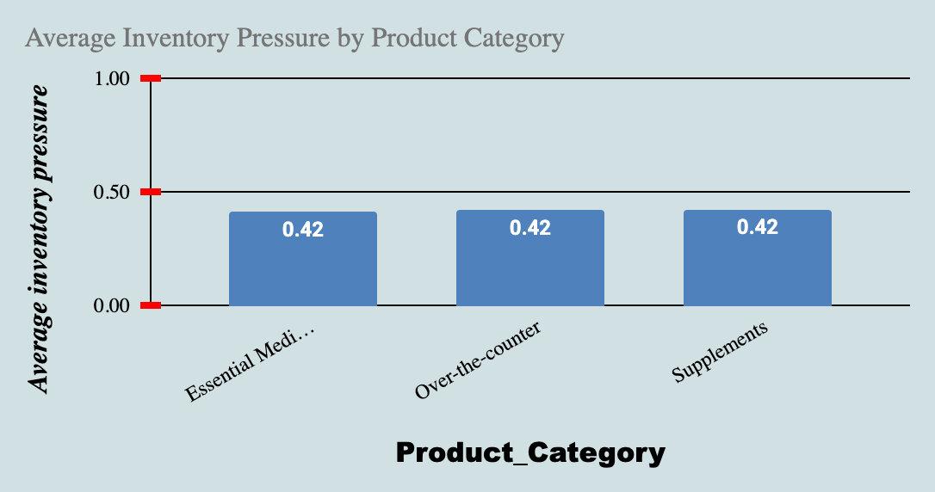
Inventory Coverage Severity
Key insight:
All categories operate below safe coverage thresholds < 0.5
Stock-out risk is systemic, not category-specific
This answers: How bad is it?

Slide 6
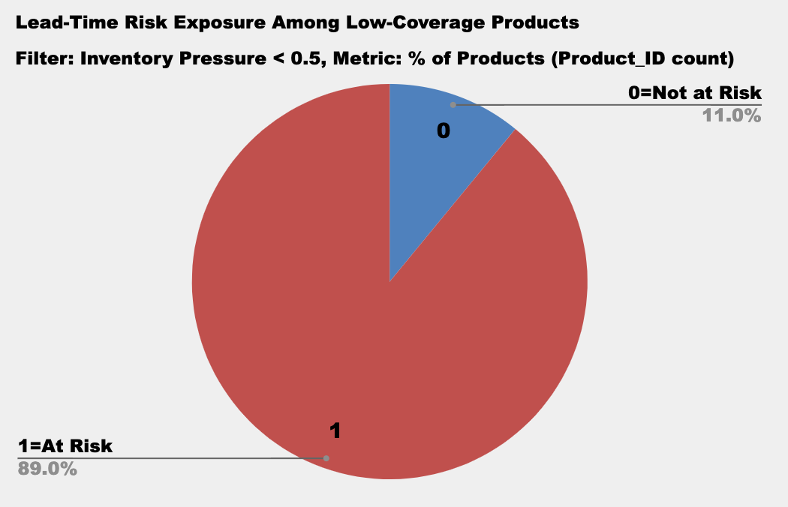
Lead-Time Risk Exposure (Root Cause)
Headline insight:
89.04% of low-coverage products cannot be replenished before stock depletion
This answers: Why is the risk so high?

Slide 7
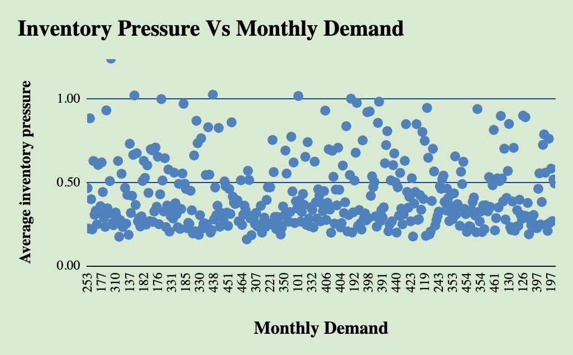
Demand & Replenishment Misalignment
Red flags:
High Monthly Demand + Low Inventory Pressure
Cluster of points below 0.5
What this diagnoses:
Forecast–inventory alignment
Understocking of high-demand SKUs

Slide 8
Business Implications
High service-level risk for essential medicines
Increased likelihood of emergency replenishment
Lost sales risk despite inventory on hand
Reduced resilience to demand spikes or supplier delays

Slide 9
Key Recommendations (Summary)
Inventory Policy
Forecasting
Supply & Promotions (In Later project)

Slide 10
Recommendations: Inventory, Replenishment & Forecasting
Increase reorder points for long-lead-time SKU
Introduce lead-time-based safety stock
Differentiate reorder quantities by demand velocity
Classify SKUs by risk tier (High / Medium / Low)
Use rolling monthly demand instead of static forecasts

Slide 11
Conclusion
Pilot revised reorder logic on high-risk SKUs
Monitor inventory pressure weekly
Integrate lead-time risk into reorder decisions

